Slide 1
Diode Clamped Multilevel Inverter
Three level Diode Clamped Inverter
DC bus voltage is split into 3 levels by two series connected capacitors
Output voltage V_{an} has 3
levels
+V_{d}/2, 0, -V_{d}/2
>

Slide 2
For V_{an} = + V_{d}/2,
S₁ and S₂ are closed
For V_{an} = - V_{d}/2,
and are closed
For V_{an} = 0, and are closed
>
V_{d}/2
V_{d}/2

Slide 3
When S₁ and S₂ are on ,
voltage across is
clamped to voltage across C₁
through as V_{dc}/2
voltage across is clamped
to voltage across C₂ through
as V_{dc}/2
>

Slide 4
Five level Diode Clamped Inverter
Voltage across each
capacitor is V_{d}/4.
Voltage stress on each
device is limited to V_{d}/4.
>

Slide 5
For V_{an} = + V_{dc}/2,
S₁ , S₂ , S₃ and S₄ are closed
For V_{an} = + V_{dc}/4,
S₂ , S_{3 ,}S₄ and S’₁ ₋are closed
For V_{an} = 0,
S_{3 ,} S_{4,} S’₁ and S’₂are closed
For V_{an} = - V_{dc}/4,
S’_{1,} S’_{2,} S’₃ and S₄ are closed
For V_{an} = - V_{dc}/2,
S’_{1,} S’_{2,} S’₃ and S’₄ are closed
>

Slide 6
Each switching device is
required to block a voltage of
V_{dc}/(m-1) volts
Clamping diodes have different
reverse voltage rating
Let S₁ , S₂ , S₃ and S₄ are closed
Voltage across D₁ is
Voltage across D₂ is
Voltage across D₃ is
Let S’_{1,} S’_{2,} S’₃ and S’₄ are closed
Voltage across D’₁ is
Voltage across D’₂ is
Voltage across D’₃ is
For an m level inverter, number of diodes
required for one phase is (m-1)(m-2)
>

Slide 7
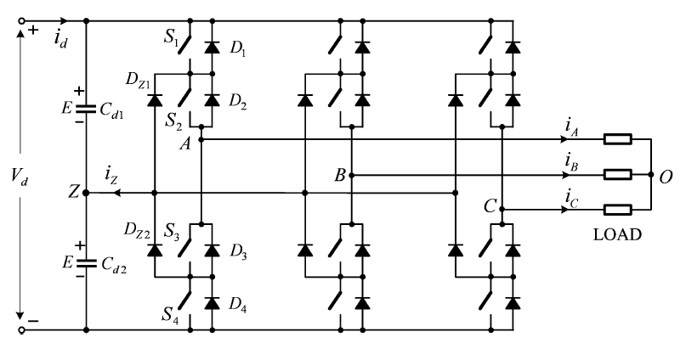
DIODE CLAMPED MLI
Three Phase Three-Level DIODE CLAMPED MLI

Slide 8
Each leg has four active switches S₁ , S₂ , S₃ , S₄ with
and four antiparallel diodes
D₁ to D₄.
The dc bus capacitor is split into
two each with a voltage of V_{d}/2
with respect to Z.
D_{Z1} and D_{Z2} are called
clamping diodes.
The capacitors are charged or discharged by neutral current i_{Z}

Slide 9
Switching states
Switching states of leg A
P denotes that the upper two
switches S₁ and S₂ of leg A
are on
Terminal voltage
v_{AZ} = + E
N indicates that the
lower two switches conduct, and v_{AZ} = – E.
Switching State (Phase A) | Device States (Phase A) |  |  |  | V_{AZ}
 | S₁ | S₂ | S₃ | S₄
P | ON | ON | OFF | OFF | E
O | OFF | ON | ON | OFF | 0
N | OFF | OFF | ON | ON | -E

Slide 10
O signifies that the inner two switches
S₂ and S₃ are on and v_{AZ} is clamped
to zero through the clamping diodes.
For a positive load current (i_{A} > 0),
D_{Z1} is on, A is connected to Z through
D_{Z1} and S₂. (i_{Z} < 0)
For a negative load current (i_{A} < 0),
D_{Z2} is on, A is connected to Z through S₃ and D_{Z2}. (i_{Z} > 0)
Switching state | Device States (Phase A) |  |  |  | V_{AZ}
 | S₁ | S₂ | S₃ | S₄
P | ON | ON | OFF | OFF | E
O | OFF | ON | ON | OFF | 0
N | OFF | OFF | ON | ON | -E

Slide 11
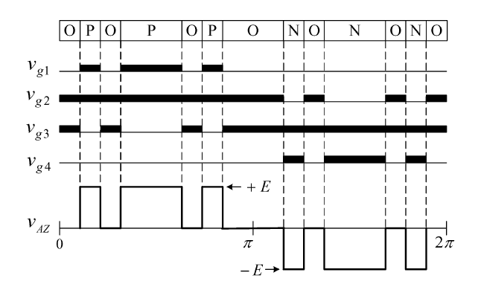
PWM of 3 Level Diode Clamped MLI
The gate signals can be generated by carrier-based modulation, space vector modulation, or selective harmonic elimination schemes etc.
OoOO
O
P
O
P
O
P
O
N
O
O
N
N
O
The waveform for v_{AZ} has three voltage levels,
+E, 0, and –E

Slide 12
PWM of 3 Level Diode Clamped MLI
The gate signals can be generated by carrier-based modulation, space vector modulation, or selective harmonic elimination schemes etc.
OoOO
O
P
O
P
O
P
O
N
O
O
N
N
O
The waveform for v_{AZ} has three voltage levels,
+E, 0, and –E

Slide 13
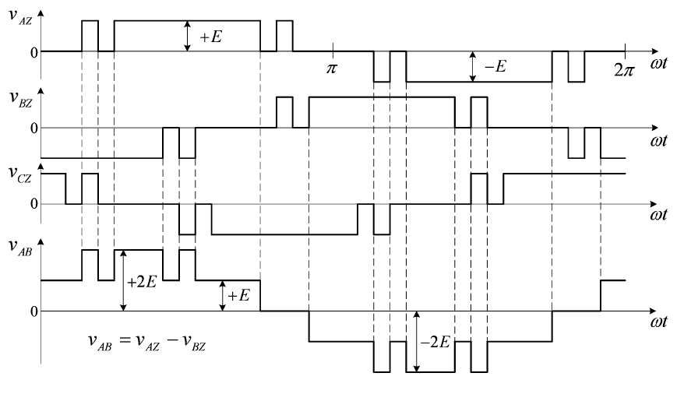
Terminal voltages and line to line voltage waveforms
v_{AZ}, v_{BZ}, and v_{CZ} are three-phase balanced with a phase shift of 2π/3 between each other.
The line-to-line voltage v_{AB} contains five voltage levels
(+2E, +E, 0, –E, and –2E).

Slide 14
Commutation of switching devices
leg A
Assumptions
Load current i_{A} is constant
during the commutation
interval due to the
inductive load
dc bus capacitors C_{d1} and C_{d2}
are sufficiently large such that
the voltage across each
capacitor is kept at
constant value E
all the switches are ideal.

Slide 15
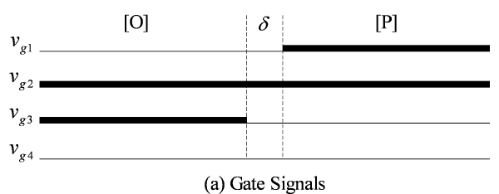
Consider the transition from
switching state [O] (S₂ & S₃)
to [P] (S₁ & S₂)
S₃ is turned off and S₁ is
turned on.
A blanking time of δ is required
in between this.
S₂
S₃
S₁
S₂
S₂
S₃
S₁
S₂
S₂
S₃
S₁
S₂
S₂
S₃
S₃
S₄
S₂
S₃
S₂
S₃
S₃
S₄
S₃
S₄

Slide 16
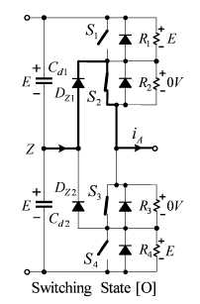
Commutation with i_{A} > 0.
during switching state [O]
S₁ and S₄ are off ,
S₂ and S₃ are on.
Positive load current (i_{A} > 0)
flows through the
clamping diode D_{Z1} and S₂
v_{S2} = 0 = v_{S3}
v_{S1} =
E
v_{S4} =
E

Slide 17
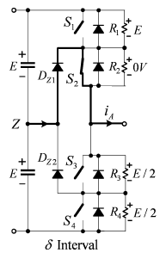
during interval δ
S₃ is being turned off ,
Path of i_{A} remains unchanged
and flows through the
clamping diode D_{Z1} and S₂
When S3 is completely switched off,
v_{S3} =
E/2
v_{S4} =
E/2

Slide 18
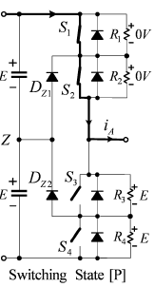
during switching state [P]
S₁ is gated on (v_{S1} = 0)
D_{Z1} is reverse-biased and turned off.
The load current i_{A} is commutated
from D_{Z1} to S₁
v_{S3} =
E
v_{S4} =
E.

Slide 19
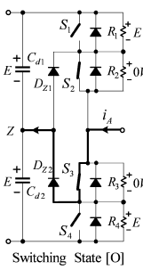
Commutation with i_{A} < 0.
during switching state [O]
S₁ and S₄ are off ,
S₂ and S₃ are on.
Negative load current (i_{A} < 0)
flows through the S₃ and
clamping diode D_{Z2}
v_{S2} = 0 = v_{S3}
v_{S1} =
E
v_{S4} =
E

Slide 20
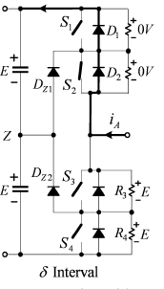
during interval δ
S₃ is being turned off ,
Negative inductive load current
i_{A} flows through diodes
D₁ and D₂
v_{S1} ≈ 0 ≈ v_{S2}
The load current is commutated
from S₃ to the diodes.
During the commutation of S₃, voltage across S₄ is clamped to E due to D_{Z2}
v_{S3} rises from zero to E and v_{S4} is kept at E.

Slide 21
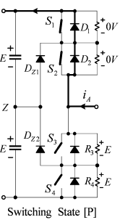
during switching state [P]
The turn-on of S₁ does not affect the operation of the circuit.
S₁ and S₂ do not carry the load current due to the conduction of D₁ and D₂.

Slide 22
all the switching devices withstand only half the supply voltage during commutation from [P] to [O] / [O] to [P] / [N] to [O] / [O] to [N] due to the clamping diodes.
Switching between [P] and [N] is not permitted.
Two switches are being turned
on and two switches are being turned off
Voltage sharing may not be same.
Switching loss is doubled.
Switching state | Device States (Phase A) |  |  |  | V_{AZ}
 | S₁ | S₂ | S₃ | S₄
P | ON | ON | OFF | OFF | E
O | OFF | ON | ON | OFF | 0
N | OFF | OFF | ON | ON | -E

Slide 23
Each of the switches in the NPC inverter withstands only half of the total dc voltage during commutation.
Drawbacks of NPC inverter
additional clamping diodes,
possible deviation of neutral point voltage.

Slide 24
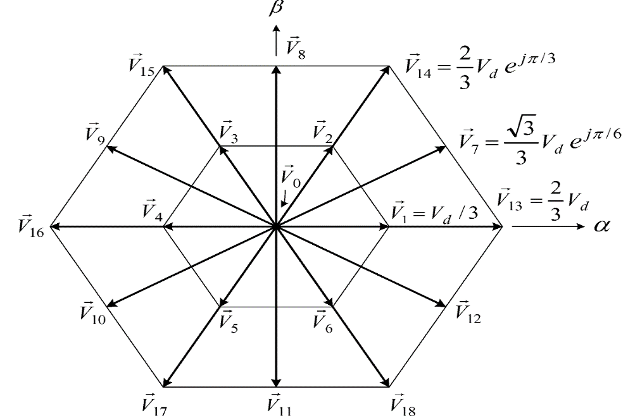
SPACE VECTOR MODULATION IN THREE PHASE THREE LEVEL INVERTER
Stationary space vectors
Each inverter phase leg has
three switching states
[P], [O], and [N].
Total 3³ = 27 possible combinations
of switching states represented
by 27 voltage vectors.
These voltage vectors can be
divided into four groups
Zero vectors
Small vectors
Medium vectors
Large vectors

Slide 25
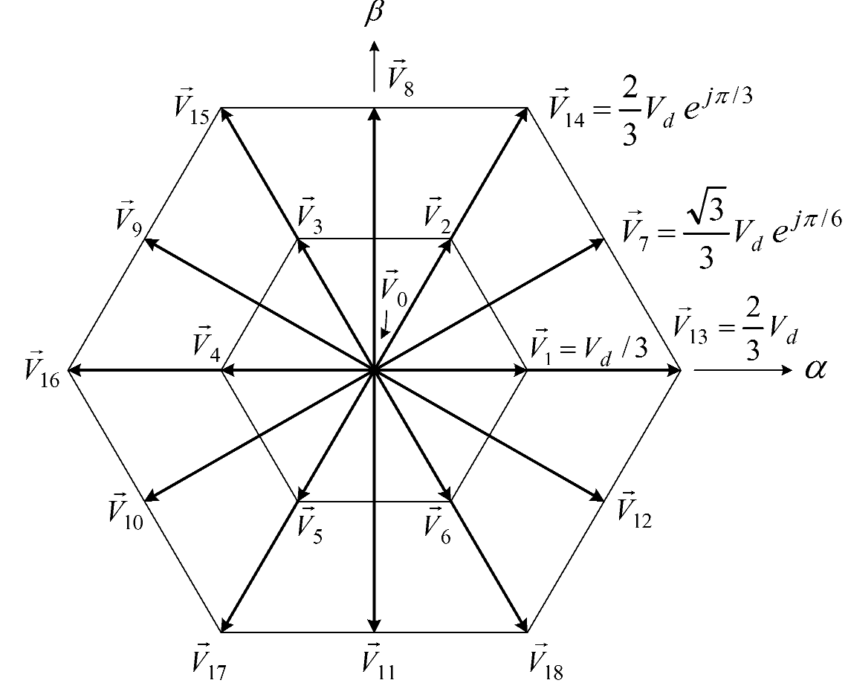
Zero vectors V₀ ,
represent three zero switching states
[PPP], [OOO], and [NNN].
The magnitude of V₀ is zero.
Space Vector | Switching State | Vector Classification | Vector magnitude
 | [PPP] [OOO][NNN] | Zero vector | 0

Slide 26
 |  | P Type | N Type | Sma l L V E C T O r | V_{d}/3
POO
ONN
PPO
OON
OPO
NON
OPP
Small vectors (V₁ to V₆ ))
NOO
Each small vector represents two switching states.
OOP
that containing [P] is called P-type small vector
NNO
POP
that containing [N] is called N-type small vector
ONO
magnitude is V_{d} /3.

Slide 27
PON
OPN
Medium vector
NPO
NOP
ONP
PNO
PNN
PPN
Medium vectors
(V₇ to V₁₂ )),
magnitude is √ 3 V_{d} /3..
NPN
Large Vector
NPP
NNP
Large vectors
( V₁₃ to V₁₈),
magnitude of 2V_{d}/3.
PNP

Slide 28
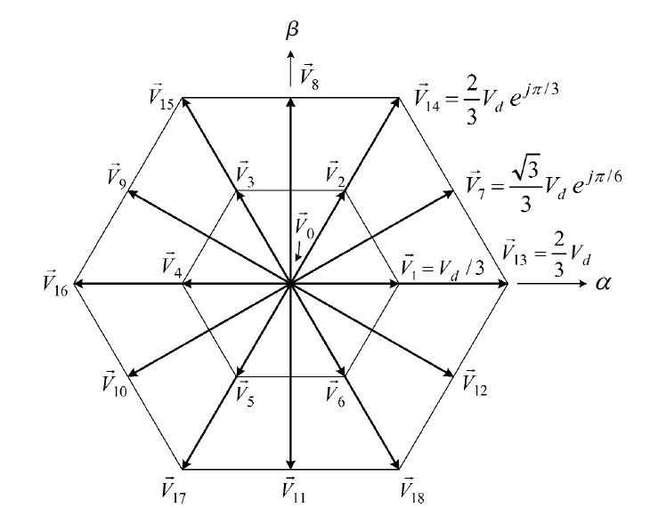
Space vector diagram is divided into six triangular Sectors (I to VI)
SECTOR II
SECTOR III
SECTOR I
SECTOR IV
SECTOR VI
SECTOR V

Slide 29
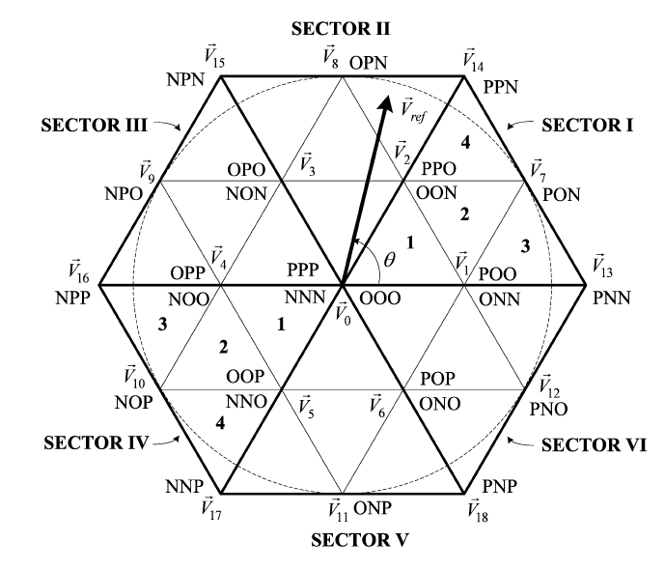
Each sector is further divided into four triangular regions (1 to 4) .
7
8
11
6
10
5
12
9
15
13
15
13
21
24
14
14
17
22
16
23
16
18
19
20

Slide 30
desired output voltage of the three phase 3level inverter
Desired output peak magnitude is V_{m}*
desired output frequency is ω*.
This three phase system results in a reference space vector of magnitude V_{m}* that rotates with an angular velocity of
ω*.

Slide 31
Inverter switches are controlled between the nearest 3 vectors of the region in which the tip of the reference phasor lies.
7
8
11
6
10
5
12
9
15
13
15
13
21
24
14
14
17
22
16
23
16
18
19
20

Slide 32
When V_{ref} lies in region1, inverter state is shifted between
Product of the reference voltage V_{ref} and sampling period T_{s}
= V₁ × interval allocated for state V₁
+ V₂ × interval allocated for state V₂
+ V₀ × interval allocated for state V₀
v₀, v₁ and v₂.
Dwell Time Calculation
based on volt-second balancing principle.

Slide 33
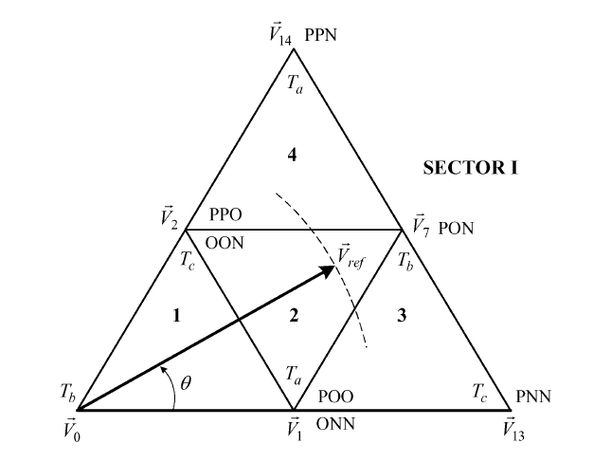
Reference vector V_{ref} can be synthesized by three nearest stationary vectors.
When V_{ref} falls into region 2 of sector I , the three nearest vectors are
V₁, V₇ and V₂
Let T_{a}, T_{b}, and T_{c} are the
dwell times for V₁, V₇, and
V₂, respectively.
V₁T_{a} + V₇T_{b} + V₂T_{c} = V_{ref}T_{s}
T_{a} + T_{b} + T_{c} = T_{s}

Slide 34
The magnitudes of voltage vectors V₁, V₂, V₇, and V_{ref} are
V₁T_{a} + V₇T_{b} + V₂T_{c} = V_{ref}T_{s}

Slide 35

Equating real and imaginary parts

Slide 36
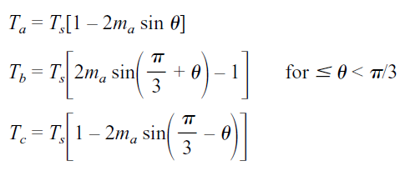

Where
The maximum length of the reference vector V_{refmax} corresponds to the radius of the largest circle that can be inscribed within the hexagon.
This is equal to the length of the medium voltage vectors.
Range of m_{a} is

Slide 37
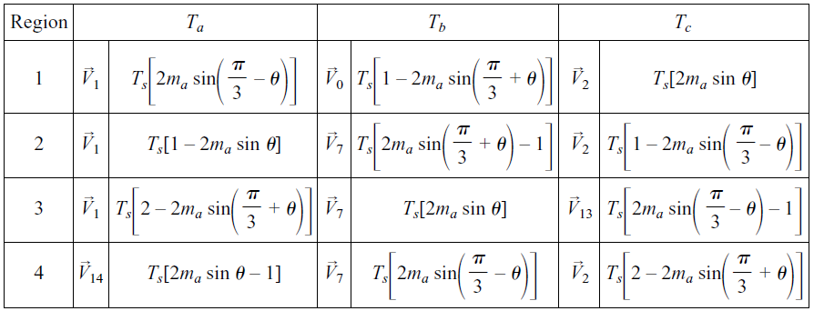
Dwell time calculation for V_{ref} in sector I

Slide 38
Region 1
Region 2
Region 3
Region 4

Slide 39
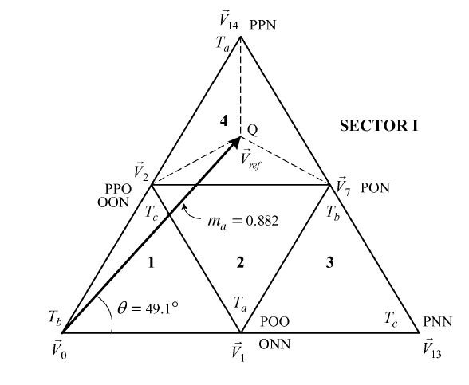
Relationship Between V_{ref} Location and Dwell Times
Assume that the head of V_{ref} points to
the center Q of region 4,
Distances from Q to V₂, V₇, and V₁₄
are the same.
The dwell times for these vectors
should be identical
When V_{ref} moves towards V₂ , longer will be the dwell time for V₂
When V_{ref} coincide with V₂,
the dwell time T_{c} for V₂ is T_{s}
T_{a} and T_{b} for V₁₄ and V₇ diminish to zero.

Slide 40
neutral point voltage v_{Z}
It depends on the switching state of the NPC inverter.
voltage between the neutral point Z and the negative dc bus is defined as neutral point voltage v_{Z .}
Voltage across C_{d1} and C_{d2} should be equal and exactly V_{d}/2.

Slide 41
Design of Switching sequence
Switching sequence is selected after considering the following factors
1. Transition from one switching state to the next should involve only two switches in the same leg.
Transition from one sector or
region to the next should
involve no or minimum
switching.
3. Neutral point voltage deviation should be minimum.

Slide 42
Assume that the inverter is in motoring mode.
Power flows from dc source to load.

Slide 43
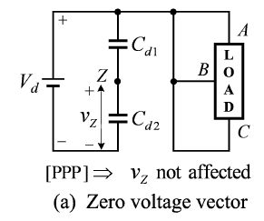
Effect of Switching States on Neutral-Point Voltage Deviation.
zero vector state V₀ [PPP]
inverter terminals A, B, and C are
connected to the positive dc bus.
The neutral point Z is left
unconnected.
This switching state does not affect v_{Z}.
other two zero switching states,
[OOO] and [NNN] also
do not cause v_{Z} to shift.

Slide 44
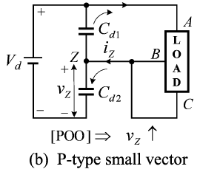
Effect of Positive small vector state on V_{z}
V₁ [POO]
terminal A is connected to the
positive dc bus.
B and C are connected to Z.
neutral current i_{Z} flows into Z, causing v_{Z} to increase.

Slide 45
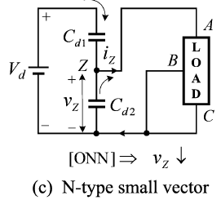
Effect of Negative small vector state on V_{z}
V₁ [ONN]
inverter terminals A is connected to Z.
B and C are connected to
negative dc bus.
neutral current i_{Z} flows out of Z, causing v_{Z} to decrease.

Slide 46
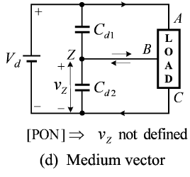
Effect of Medium vector state
V₇ [PON]
terminals A is connected to the
positive dc bus.
B is connected to Z.
C is connected to N.
Depending on the inverter operating conditions, the neutral-point voltage v_{Z} may rise or drop.

Slide 47
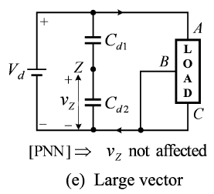
Effect of Large vector state
V₁₃ [PNN]
terminals A is connected to the
positive dc bus.
B and C are connected to N.
Z is left unconnected. Hence, neutral-point voltage v_{Z} is not affected.

Slide 48
It can be summarized that
Zero vectors V₀ do not affect the neutral point voltage v_{Z}.
Small vectors V₁ to V₆ have influence on v_{Z}.
P-type small vectors make v_{Z} increase,
N-type small vectors cause v_{Z} to decrease.
Medium vectors V₇ to V₁₂ also affect v_{Z}, but the direction of voltage deviation is undefined.
The large vectors V₁₃ to V₁₈ do not affect neutral-point voltage.

Slide 49
Design of Switching sequence
Switching sequence is selected after considering the following factors
1. Transition from one switching state to the next should involve only two switches in the same leg.
Transition from one sector or
region to the next should
involve no or minimum
switching.
3. Neutral point voltage deviation should be minimum.

Slide 50
Switching Sequence with Minimal Neutral-Point Voltage Deviation.
A P-type small vector causes the neutral-point voltage v_{Z} to rise while an N-type small vector makes v_{Z} fall.
To minimize the neutral-point voltage deviation, dwell time calculated during one sampling period T_{s} for a small vector is equally divided to the two small vectors (P- and N-type switching states ) available at that point.

Slide 51
Case 1 One Vector among the three selected vectors is a small vector.
Consider that V_{ref} is in region 4 of Sector I.
It can be synthesized by one small vector V₂, one medium vector V₇ and one large vector V₁₄.
The small vector V₂ has two switching states [PPO] and [OON].
To minimize the neutral voltage
deviation, the dwell time for V₂
should be equally distributed
between the states {[PPO] and [OON]}.

Slide 52
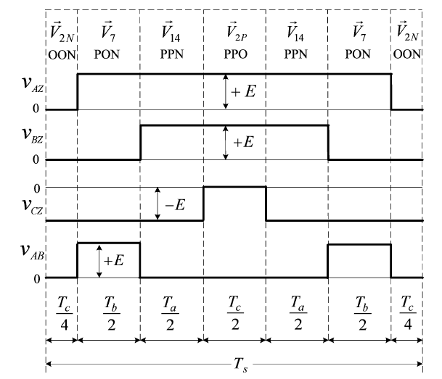
sampling period of the PWM pattern (T_{s} = T_{a} + T_{b} + T_{c}).
S₂
S₃
S₁
S₂
S₁
S₂
S₁
S₂
S₁
S₂
S₁
S₂
S₂
S₃
During the transition from [OON] to [PON] S₁ is turned on and S₃ is turned off. Only two switches are involved.
The dwell time T_{c} for small vector V₂ is equally divided between the P- and N-type switching states.
This minimizes the neutral point voltage deviation.

Slide 53
S₂
S₃
S₁
S₂
S₁
S₂
S₁
S₂
S₁
S₂
S₁
S₂
S₂
S₃
Among the four switching devices in an inverter leg, only two are tuned on and off once per sampling period.
The transition for V_{ref} moving from one sector (or region) to the next does not involve any switching,

Slide 54
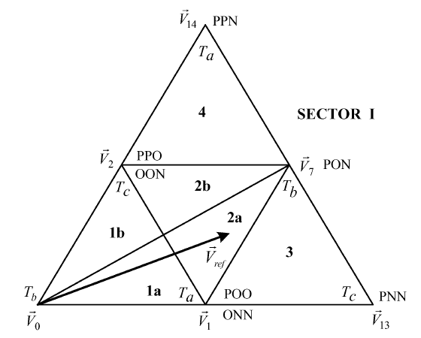
Case 2: Two Small Vectors Among Three Selected Vectors.
To reduce the neutral voltage deviation, each of the two regions is further divided into two sub regions
Assume that V_{ref} lies in region 2a.
It can be approximated by
V₁, V₂, and V₇.
When V_{ref} is in region 1 or 2 of sector I , two of the three selected vectors are small vectors.

Slide 55
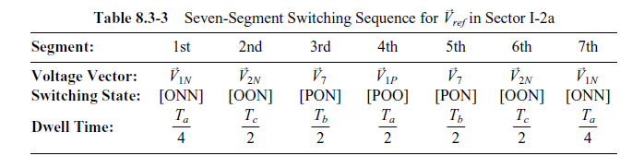
Since V_{ref} is closer to V₁ than V₂, the corresponding dwell time T_{a} for V₁ is longer than T_{c} for V₂.
The vector V₁ is referred to as
dominant small vector whose
dwell time is equally divided
between V_{1P} and V_{1N} .

Slide 56
V_{ref} is closer to V₂ than V₁, the corresponding dwell time T_{c} for V₂ is longer than T_{a} for V₁.
V₂ is the dominant small vector
Its dwell time is equally divided
between V_{2P} and V_{2N} .
OON
PON
POO
PPO
POO
PON
OON
T_{b}/2
T_{c}/4
T_{c}/4
T_{b}/2
T_{a}/2
T_{c}/2
T_{a}/2

Slide 57
Causes of Neutral-Point Voltage Deviation
In addition to the influence of small- and medium-voltage vectors, the neutral-point voltage may also be affected by
Unbalanced dc capacitors due to manufacturing tolerances
Inconsistency in switching device characteristics
Unbalanced three-phase operation
To minimize the neutral-point voltage shift, a feedback control scheme can be implemented, where the neutral-point voltage is detected and then controlled.

Slide 58
Three level capacitor clamped (Flying Capacitor) MLI
For V_{an} = + V_{d}/2,
S₁ and S₂ are closed
V_{an}= V_{c2} = V_{d}/2
For V_{an} = - V_{dc}/2,
S’₁ and S’₂ are closed
V_{an}= V_{c2} = -V_{dc}/2
For V_{an} = 0, S₁ and S’₁ are closed
or
S₂ and S’₂ are closed
+
-
n
+
a
-
+
-
n
a

Slide 59
Five level capacitor clamped MLI
For V_{an} = + V_{dc}/2,
S₁ , S₂ , S₃ and S₄ are closed
For V_{an} = - V_{dc}/2,
S’₁ , S’₂ , S’₃ and S’₄ are closed
For V_{an} = + V_{dc}/4,
1. S₁ , S_{2 ,}S₃ and S’₁ ₋are closed
-
+
-
+
+
-
V_{d}/2
V_{d}/4
-V_{d}/2
-V_{d}/4

Slide 60
2. S₄ , S₃ , S₂ and S’₄ are closed
3. S₄ , S₃ , S’₃ and S₁ are closed
For V_{an} = - V_{dc}/4,
1. S’₁ , S’₂ , S’₃ and S₁ are closed
2. S₄ , S’₂ , S’₃ and S’₄ are closed
3. S’₁S₃ S’₃ and S’₄are closed

Slide 61
For V_{an} = 0,
1. S₁ , S₂ , S’₁ and S’₂ are closed
2. S₃ , S₄ , S’₃ and S’₄ are closed
3. S₁ , S₃ , S’₁ and S’₃ are closed
4. S₁ , S₄ , S’₂ and S’₃ are closed
5. S₂ , S₄ , S’₂ and S’₄ are closed
6. S₂ , S₃ , S’₁ and S’₄ are closed

